Slide 1
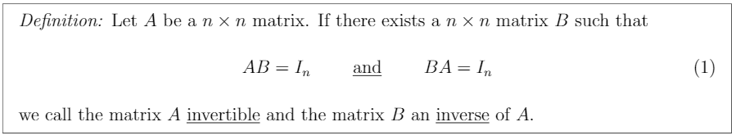
Invertible definition
- By symmetry, if the matrix A is invertible with inverse B, then matrix B is also invertible with inverse A.
- ((A^-1)^-1) = A.

Slide 2
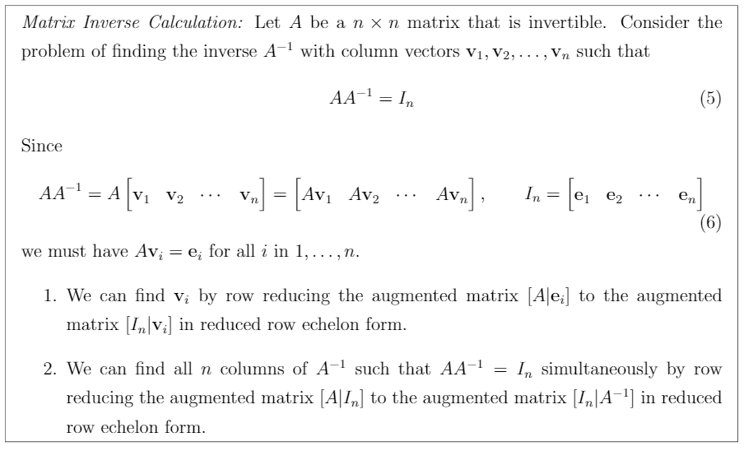
Matrix Inverse Calculation

Slide 3
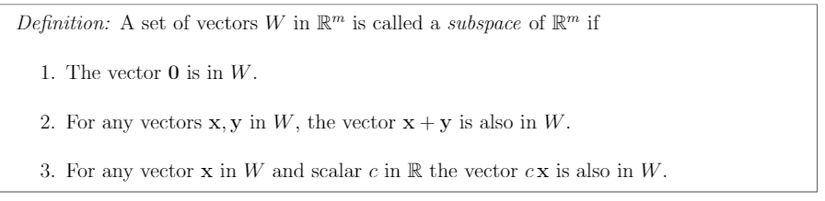
Subspace

Slide 4

Subspace and Span

Slide 5
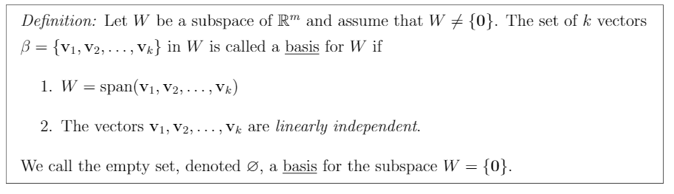
Basis

Slide 6
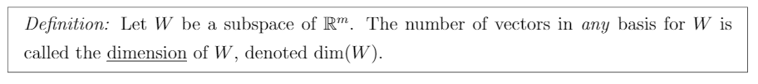
Dimension

Slide 7
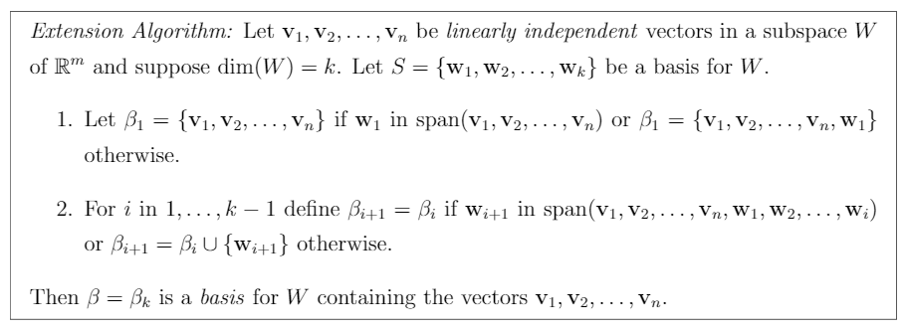
Extension Algorithm

Slide 8
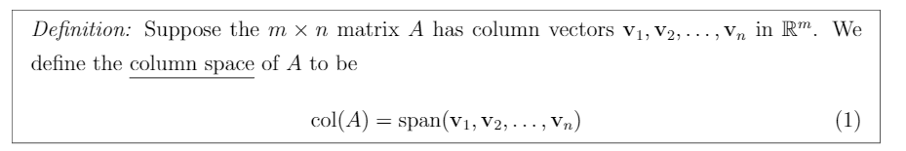
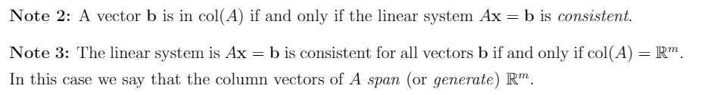
Column Space

Slide 9
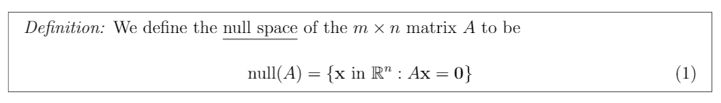
Null Space

Slide 10
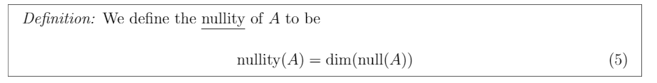
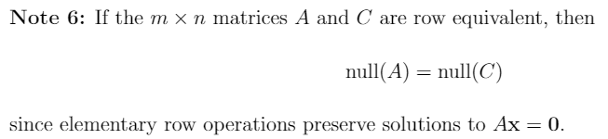
Nullity

Slide 11

Tranformation

Slide 12
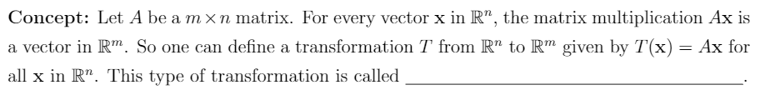
Transformation Type (TBA)

Slide 13
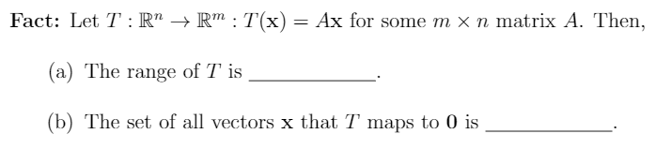
Range and Vector set of T (TBA)

Slide 14
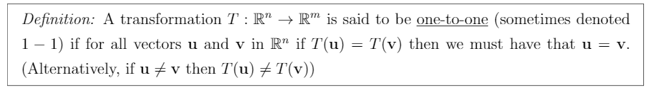
One To One

Slide 15
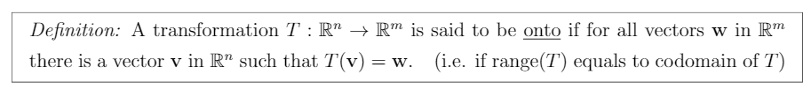
Onto

Slide 16
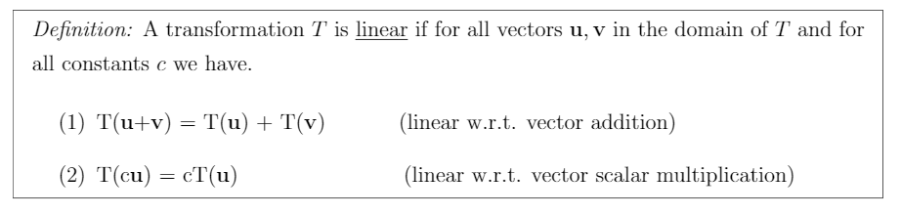
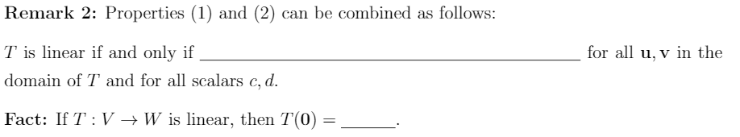
Linear Transformation

Slide 17
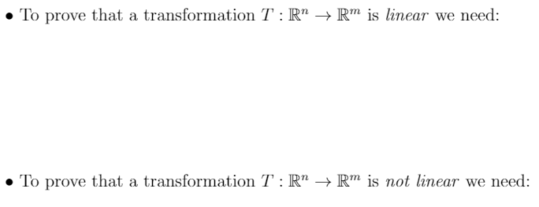
Linear/Nonlinear Transformation (TBA)

Slide 18
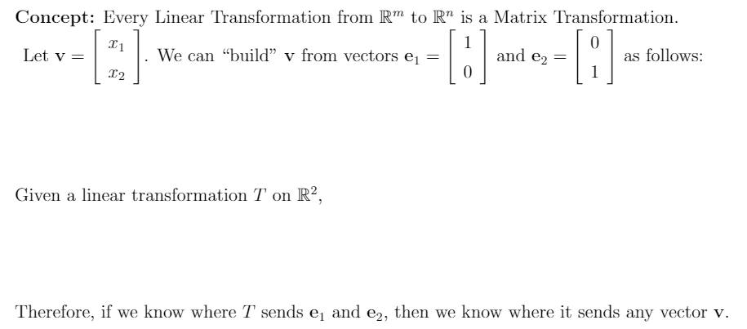
Linear To Matrix Transformation(TBA)

Slide 19
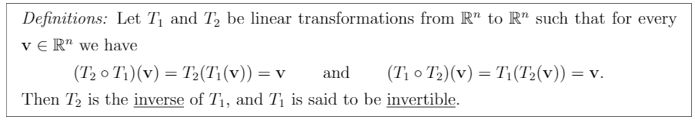
Linear Matrix Inverse

